Slide 1
Singleton Class
PRESENTED BY
VAISHALI GOJE

Slide 2
Contents
Definition
Use Of Singleton Class
Creating Singleton Class
Example
Advantages

Slide 3
What Is Singleton Class
A singleton class in Java ensures only one instance of itself exists. To make one, create a class with a private static instance variable and a private constructor.

Slide 4
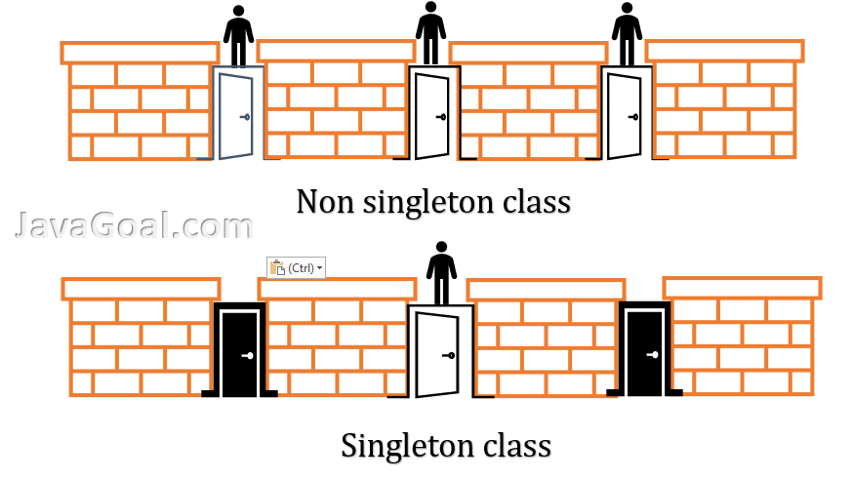

Slide 5
Why We Use Singleton Class
If there are several similar requirement and we have to create only one object and reuse the same object for every similar requirement.

Slide 6
How To Create A Singleton Class
Create a class with a private static instance variable and a private constructor.
Then, provide a public static method to access the instance.
This method checks if the instance exists; if not, it creates one.
You'll always get the same instance wherever you call the method.

Slide 7
Singleton Class with Eager Initialization
public class Singleton {
private static final Singleton instance = new Singleton();
private Singleton() {}
public static Singleton getInstance() {
return instance;
}
}

Slide 8
Singleton Class with Lazy Initialization
public class Singleton {
private static Singleton instance;
private Singleton() {}
public static synchronized Singleton getInstance() {
if (instance == null) {
instance = new Singleton();
}
return instance;
}
}

Slide 9
Advantages of Singleton Class
Single Point of Control
Improved Performance
Global Access
Flexibility

Slide 10
THANK YOU

